Slide 1
Variance Reduction Techniques
Techniques to improve convergence in Monte Carlo Simulations
Renato Barros
March 20, 2018

Slide 2
Section 1
The Problem at Hand

Slide 3
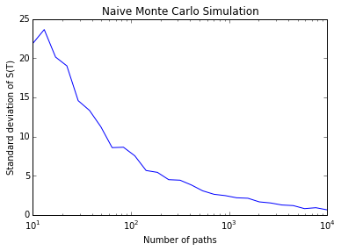
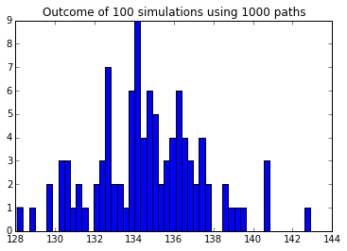
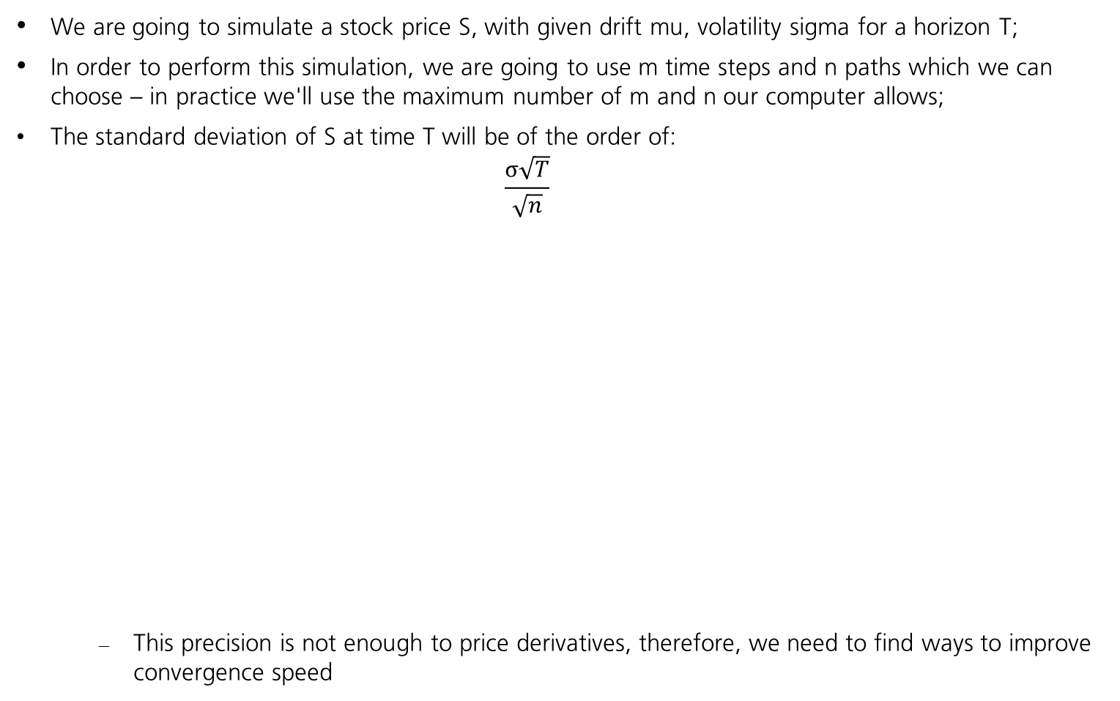
Monte Carlo Convergence Speed
We are going to simulate a stock price S, with given drift mu, volatility sigma for a horizon T;
In order to perform this simulation, we are going to use m time steps and n paths which we can choose – in practice we'll use the maximum number of m and n our computer allows;
The standard deviation of S at time T will be of the order of:
$$\frac{σ\sqrt{T}}{\sqrt{n}}$$
This precision is not enough to price derivatives, therefore, we need to find ways to improve convergence speed

Slide 4
Section 2
Antithetic Sampling and Moment Matching Techniques

Slide 5
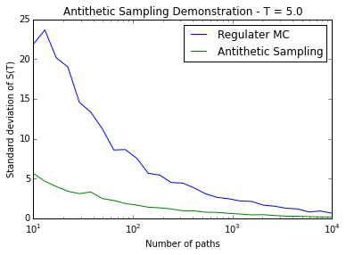
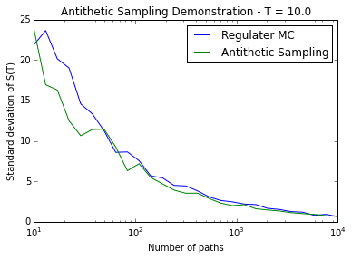
Antithetic Sampling
The idea is to use mirrored increments, ie, instead of generating n paths Brownian increments for each time step, we generate only n/2 and for the n/2 remaining paths, we use increments of same magnitude but with different sign
It works best for smaller values of T. Why is this the case?

Slide 6
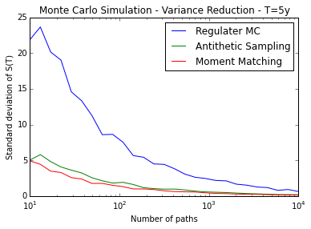
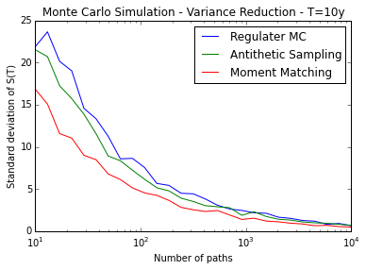
Moment Matching – part 1
The Brownian increments generated are not necessarily N(0, 1)
Moment matching involves re-normalizing the Brownian increments at each time step to force them to conform to N(0,1)
dW'(t) = [dW(t) – mean(dW(t))] / stdev (dW(t))
This renormalization introduces some dependency between paths, but nothing to be concerned about

Slide 7
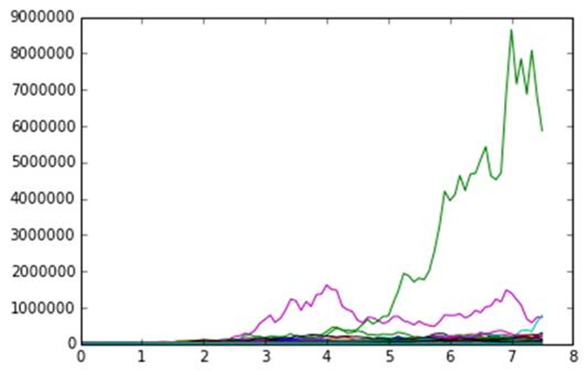
Moment Matching - part 2
We know that S(T), also called forward price of maturity T is given by:
S(T) = S(0) exp( mu T )
Therefore, we can re-normalize our simulated stock price directly at each time step, instead of re-normalize the Brownian increments, to force the simulated mean to match the forward price;
This "brutte force technique" is very powerful as the simulated price is forced to converge to its theoretical value;
In most financial applications, this is a requirement, therefore this technique must be used;
Now, think what happens in case we have one explosive path. What will happen to the other paths when we perform this normalization step? How to remediate it?

Slide 8
Section 3
Importance Sampling

Slide 9
Options
Options give you the right but not the obligation to buy the stock at a given price – strike, denoted K, at the moment of the option expiry T;
To price an option using Monte-Carlo, we simulate the stock up to the expiry date;
Then we compute:
Call price = mean( max(S(T) – K, 0 ) x exp(-rT) => where r is the risk free interest rate
Put price = mean( max(K – S(T), 0) x exp(-rT)
To price options precisely, first we need the forwards to be priced very precisely;
The option price

Slide 10
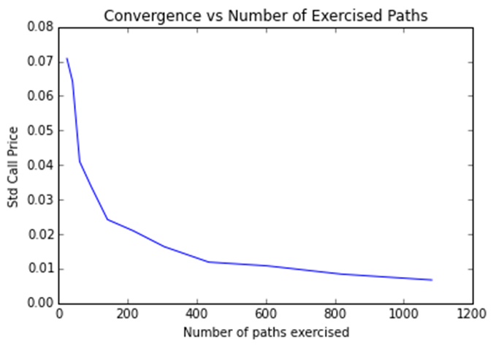
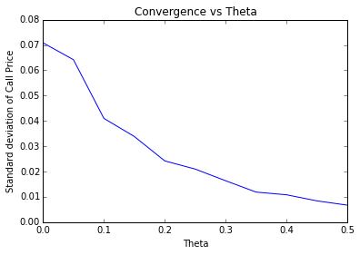
Option price convergence
The convergence of option prices will depend on the number of paths whereby the stock is above (below) the strike K at expiry for calls (puts);
As shown in the plot, the convergence of the call price depends on the number of paths in which the option is exercised;
But how to vary the number of exercise paths?

Slide 11
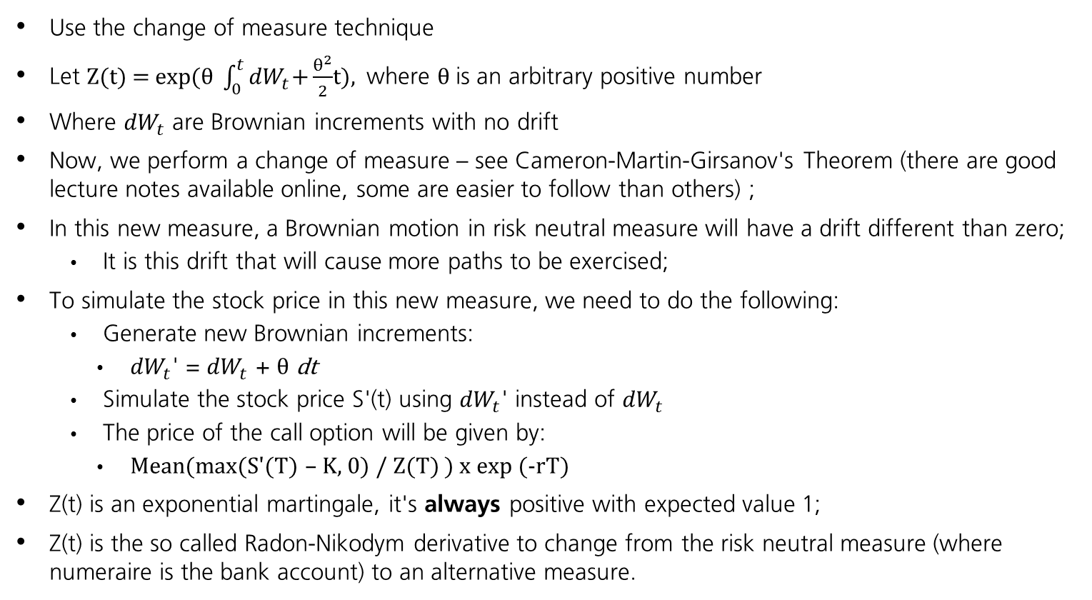
Change of Measure
Use the change of measure technique
Let Z(t) = exp($θ \int_{0}^{t}{{dW}_{t}\text{+}\frac{θ^{2}}{2}}$t), where $θ$is an arbitrary positive number
Where ${dW}_{t}$ are Brownian increments with no drift
Now, we perform a change of measure – see Cameron-Martin-Girsanov's Theorem (there are good lecture notes available online, some are easier to follow than others) ;
In this new measure, a Brownian motion in risk neutral measure will have a drift different than zero;
It is this drift that will cause more paths to be exercised;
To simulate the stock price in this new measure, we need to do the following:
Generate new Brownian increments:
${dW}_{t}$' = ${dW}_{t}$ + $θ$ dt
Simulate the stock price S'(t) using ${dW}_{t}$' instead of ${dW}_{t}$
The price of the call option will be given by:
Mean(max(S'(T) – K, 0) / Z(T) ) x exp (-rT)
Z(t) is an exponential martingale, it's always positive with expected value 1;
Z(t) is the so called Radon-Nikodym derivative to change from the risk neutral measure (where numeraire is the bank account) to an alternative measure.

Slide 12
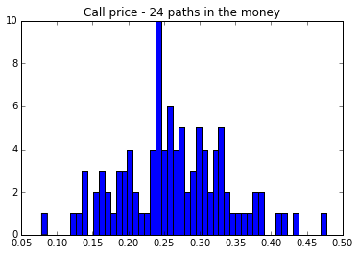
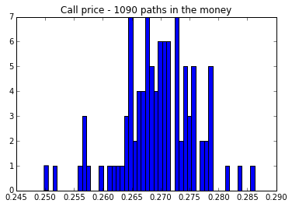
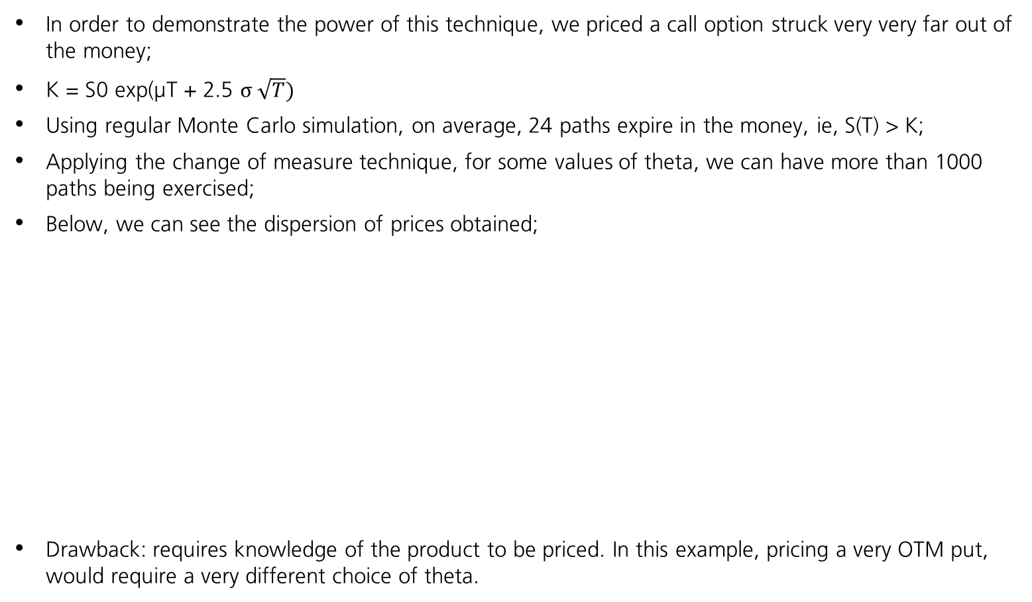
Importance Sampling - Results
In order to demonstrate the power of this technique, we priced a call option struck very very far out of the money;
K = S0 exp(μT + 2.5 $σ \sqrt{T})$
Using regular Monte Carlo simulation, on average, 24 paths expire in the money, ie, S(T) > K;
Applying the change of measure technique, for some values of theta, we can have more than 1000 paths being exercised;
Below, we can see the dispersion of prices obtained;
Drawback: requires knowledge of the product to be priced. In this example, pricing a very OTM put, would require a very different choice of theta.

Slide 13
Section 4
Variate Recycling

Slide 14
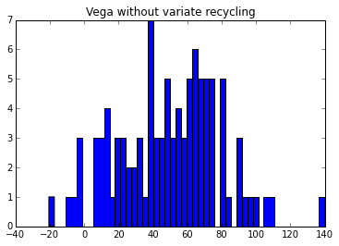
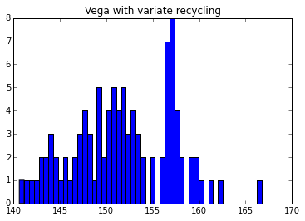
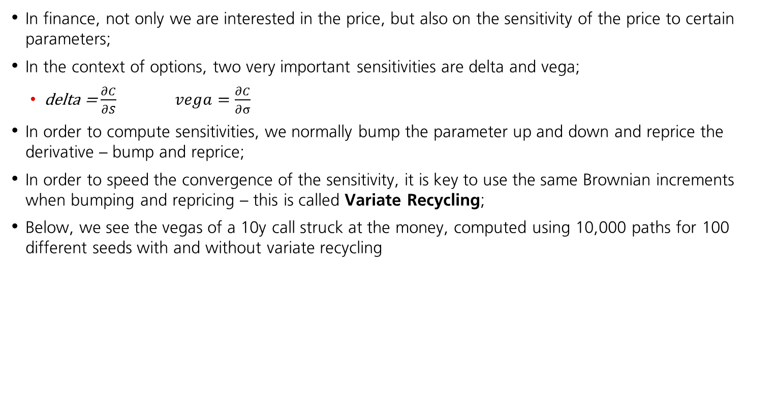
Variate Recycling - Computing Sensitivities
In finance, not only we are interested in the price, but also on the sensitivity of the price to certain parameters;
In the context of options, two very important sensitivities are delta and vega;
delta = $\frac{∂C}{∂S} vega=\frac{∂C}{∂σ}$
In order to compute sensitivities, we normally bump the parameter up and down and reprice the derivative – bump and reprice;
In order to speed the convergence of the sensitivity, it is key to use the same Brownian increments when bumping and repricing – this is called Variate Recycling;
Below, we see the vegas of a 10y call struck at the money, computed using 10,000 paths for 100 different seeds with and without variate recycling

Slide 15
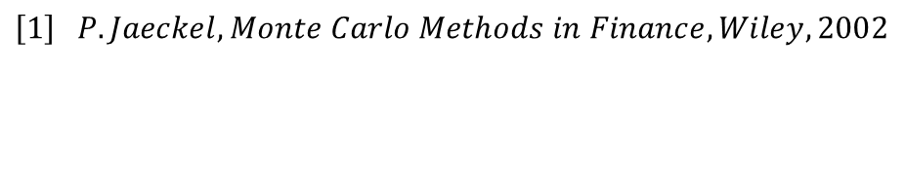
Bibliography
$$\left[1\right] P. Jaeckel, Monte Carlo Methods in Finance, Wiley, 2002$$
[2] galton.uchicago.edu/~lalley/Courses/390/Lecture10.pdf

